Slide 1

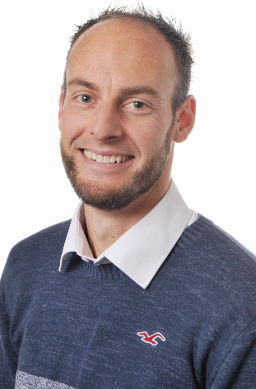
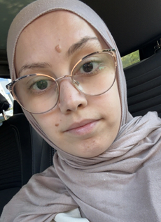
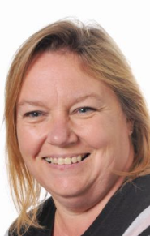
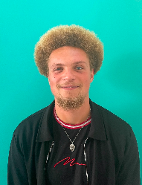
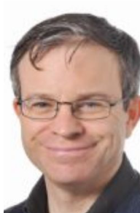
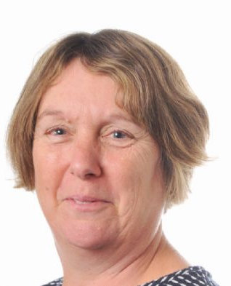
Welcome to Year 4
Mr Buley
Class Teacher
Miss Darsouni Class Teacher
Mr Crooks Class Teacher
Mrs Brown Cover Teacher
Mr Murray
Teaching Assistant
Mrs Kirby
Teaching Assistant
Miss Mason-Healey Class Teacher
Notes:
Thank you so much for coming.

Slide 2
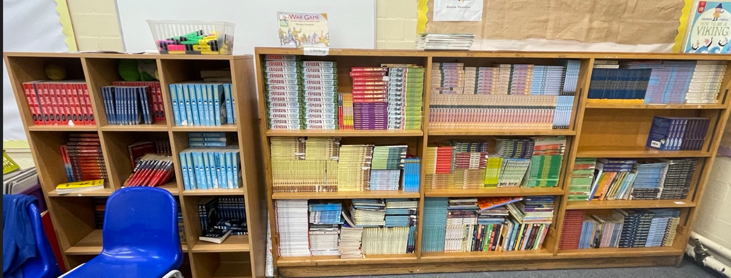
A typical day in Year 4
8:45 – 9:00 – Early Morning Task
9:00 – 9:45 – Guided Reading
9:45 – 10:40 – Maths
10:40 – 11:00 – Break Time
11:05 – 11:30 – Times Tables / Mental Maths
11.30 – 12.30 – English
12:30 – 1:30 – Lunch Time
1:30 – 2:00 - Spelling
2:00 – 3:00 – Foundation Subjects
3:00 – 3:15 – Story and End of the Day Routines
In school
No hands up
Think, pair, share
Cold calling
PE is on a Thursday this term

Slide 3
Uniform and presentation
Wearing our school uniform helps children feel part of our school community and encourages pride in their appearance. Parents can choose items from the uniform list based on what works best for their child and the season.
Girls:
Black or grey skirts, trousers, or pinafore dresses
Blue and white gingham summer dresses
Light blue polo shirts
Royal blue sweatshirts or cardigans with school logo
Sensible, flat, comfortable shoes (black or brown)
Boys:
Black or grey trousers or shorts
Light blue polo shirts
Royal blue sweatshirt with school logo
Sensible, flat, comfortable shoes (black or brown)
All Children:
Sun hats, warm hats, and gloves
Black shorts and white t-shirt for PE
Trainers for PE

Slide 4


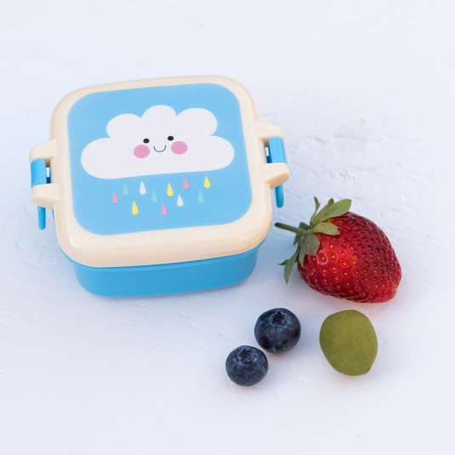
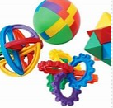

Every day…
Bring reading book and reading record.
Snack
Bagels are provided for children at break times. If you would like to provide your child with an alternative snack, please make sure this is healthy (no crisps or chocolate please).
Water bottle
Please ensure this only contains water; no juice or squash. Thank you.
Children are encouraged to go to the toilet at break and lunch time so as not to disrupt learning time - please let us know if your child has a medical reason for needing to go more often.
Please do not bring any toys/ fiddle toys to school unless agreed by the class teacher.

Slide 5
Topics in Year 4
Rainforest – why rainforests are important, why we need to protect them and what we can do to protect them (geography)
Earthquakes and volcanoes – causes and effects of earthquakes and volcanoes, where they occur and how the effects of natural disasters are managed. (geography)
The Anglo-Saxons and The Vikings – what was life like for a Roman citizen, why the Roman army was so successful and how the Romans have influenced our lives today. (history)
Rivers – features of a river, why rivers are important, what we can do to protect rivers and the different human and physical features in our local area (geography)

Slide 6

Upcoming Trips and Events
Autumn
Zoolab – Rainforest Unwrapped (school)
Geo bus – Virtual workshop on Earthquakes
Summer
Gilbert White Centre - River Fieldwork Trip (Selbourne)

Slide 7
Year 4 Multiplication Tables Check (MTC)
This will take place between 1-12 June 2026
It will test your child’s recall of 1-12 times tables
It consists of 25 questions and 3 practise questions
They have 6 seconds to answer each question
If some children have specific needs or you have any concerns about your child accessing the check please speak to us so we can make alternative arrangements.
We will share your child’s score in their end of year report
Maths Frame is a great way of practising for the check https://mathsframe.co.uk/en/resources/resource/477/Multiplication-Tables-Check

Slide 8
MTC in Year 4 – How can I help my child?
Practise saying the table - It is important to say the whole times table and not just the answer
Test your child through quick fire questions (out of order)
Keep revisiting previous times tables that they learnt so they do not forget them
Encourage them to write them down as well as practise saying them verbally
Try displaying the ones they find tricky around the house so they see them everywhere
Times Table Rock Stars is a great way to practise – if you need a login let us know.
You could make up rhymes , look for patterns, say in silly voices etc
Hit the Button and other Top Marks Games https://www.topmarks.co.uk/maths-games/7-11-years/times-tables
Mathsframe also has many fun times table games https://mathsframe.co.uk/en/resources/category/7/multiplication-and-division

Slide 9



Reading and writing
For the third year, we have been running our writing, reading, and spelling programme to develop children’s literacy skills.
The programme continues to have a very positive impact, giving pupils access to a wide range of high-quality texts to inspire their reading and writing.
We have made a significant investment in books, so that in every reading and writing lesson, children share a copy one between two: ensuring everyone can fully engage with the texts.
Spelling
This year, we are introducing half-termly spelling tests that focus on key spelling rules taught in your child’s year group. Each week, your child will bring home a spelling sheet highlighting the spelling rule they are learning.
We encourage children to find additional words that follow the same rule and practise them at home. The weekly spelling sheet will also include a range of fun and engaging ways to practise spellings outside of school.

Slide 10
Supporting your child at home
Reading
Hearing your child read aloud at least four times, per week
Children bring their books bags back, every day
Encourage them to read anything - it doesn’t have to be a school book
They can change their book in the morning when required
Focus on fluency, expression and understanding vocabulary when reading at home
Ask them questions about what has happened in the story to help support their comprehension (focus is retrieval and inference)
Maths
Learning their 1-12 times tables for accuracy and fluency
Learning for life - Telling the time and Money
If you would like worksheets or further support for maths done in class then please let us know
Spelling
We encourage children to find additional words that follow the same rule and practise them at home. The weekly spelling sheet will also include a range of fun and engaging ways to practise spellings outside of school.

Slide 11
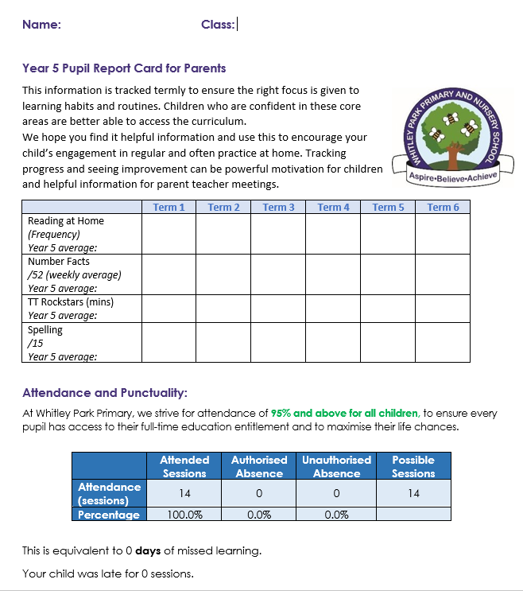
Half-termly reports
At Whitley Park, we strongly believe that children learn best when there is a strong partnership between school and home. When parents are informed and actively support their child’s learning, progress is strengthened.
Children having fluency in the core skills of reading , spelling and number are essential and the best way to ensure this fluency is through regular practice both in school and at home.
Our recent letter detailed how we will report to you on your child’s progress across the year in these key areas.
This will include:
Your child’s current attendance
The number of times they have read at home
Their most recent spelling scores
Number facts / times table scores
Number of minutes sent on ‘Times Table Rockstar’s

Slide 12




Reading
Spelling
Children read at home at least 4 times a week
Please record this in their reading record books
Reading records and reading books need to be in school each day
The number of reads each child has done will be recorded each week
Children will bring home a spellings sheet weekly
Encourage them to practice the spellings at home and find more words with the same rule
Each half term children will be tested on the spelling rules for their year group so you can track their progress across the year
Times Tables
Number Fluency
Children have their login for times table Rockstars in their reading record book
We encourage daily practice of these using the fun and interactive games
The amount of minutes they spend on here will be reported each half term
Children have 4 sessions a week of number fluency, each half term they are tested against their year group objectives and their score will be reported in the half termly report

Slide 13
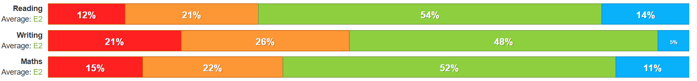
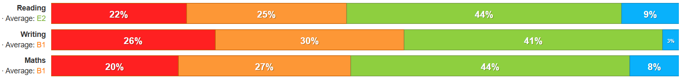
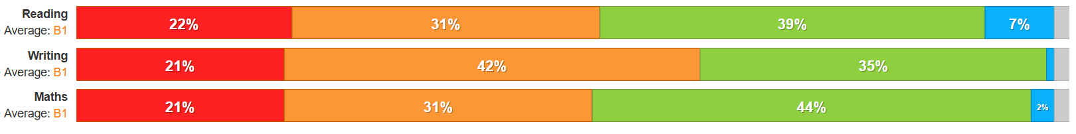
Impact of attendance on attainment
Good attendance is essential for your child’s learning and progress. Each missed session can create gaps in their understanding, which can build up over time and affect their overall achievement.
Good Attendance 95% - 99%
At risk of persistence absence 5-10% of sessions missed
Persistent absence 10% or more sessions missed

Slide 14
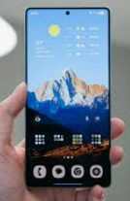



Children and parents will need to sign a phone contract before your child can bring their phone into school.
We’ve recently noticed an increase in situations where children have been unkind to one another through messaging and group chats. We’re also seeing more children coming to school tired, often due to staying up late on devices. This can make it harder for them to fully engage in their learning during the day.
We know how challenging it can be to manage technology use at home, and we really appreciate your ongoing support. Here are a few ways you can help your child build healthy habits around technology:
Encourage device use in shared family spaces
Keep devices out of bedrooms at bedtime
Check phones regularly together and keep communication open
Make sure parental controls are in place and up to date
Stay informed about the apps and games your child is using, including the potential risks
Have regular conversations about what they’re watching, and who they’re messaging or chatting with
Thank you for working with us to support your child’s wellbeing and readiness to learn.
Snap chat
Age 13
Tik Tok
Age 13
Whatsapp
Age 13

Slide 15
Any questions?

