Slide 1

Phonics at Whitley Park
Reception parents meeting

Slide 2
Welcome!
We will first be visiting a Phonics lesson in action

Slide 3
Why is reading so important?
Reading is the key to unlocking a child's wider learning
Reading helps build children's vocabulary, imagination and understanding of the world around them
At Whitley Park we help children learn to decode words, build fluency and nurture a love for reading and story books.

Slide 4

Read Write Inc.
It is a highly effective phonics-based reading programme that helps children learn with confidence and enjoyment
Through these fun, interactive, fast-paced lessons, children learn to become independent readers
Children make progress at their own level

Slide 5
Before your child can learn to read they need to learn to..
Say the sound that is represented by each letter or groups of letters.
Know how to blend the sounds together in a word to read it, e.g. c-a-t, cat.
In Read Write Inc. We call them 'speed sounds' because we want children to read them effortlessly.
We use pure sounds, rather than letter names, so the children are able to blend the sounds with ease.

Slide 6
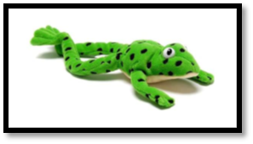
Meet Fred!
You could try Fred talk at home!

Slide 7
Handwriting
Each letter sound has a picture – these are on the sound mats in your home reading packs
Each picture has a rhyme to help the children remember how to write them
It is really important to practice writing in lower case letters

Slide 8
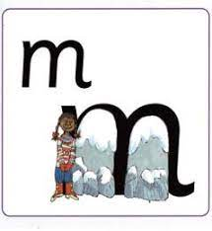
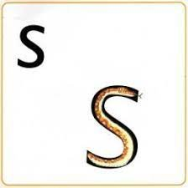
m - Maisy, mountain, mountain
s - slither down the snake

Slide 9
Groupings
Each child is carefully matched to a group through half-termly assessments
Group A
Group B
Group C
Ditty
Red
Green (End of Reception expectation)
Purple
Pink
Orange
Yellow
Blue (end of Year 1 expectation)
Grey
Comprehension (Spring term expectation for Year 2)

Slide 10
Green words
ship | sh | i | p
Once your child can use orally blend, they will learn to blend written words in Ditty group.
The green word cards have a dot or “sound button” under each sound.
Words that contain “special friends” (two letters which together make one sound such as sh, th, ch) have a line under the letters that make up the “special friends”.

Slide 11
Red words
These are words that the children can’t use “Fred Talk” to read.
Children learn these words through regular exposure and explicit teaching.

Slide 12
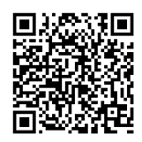
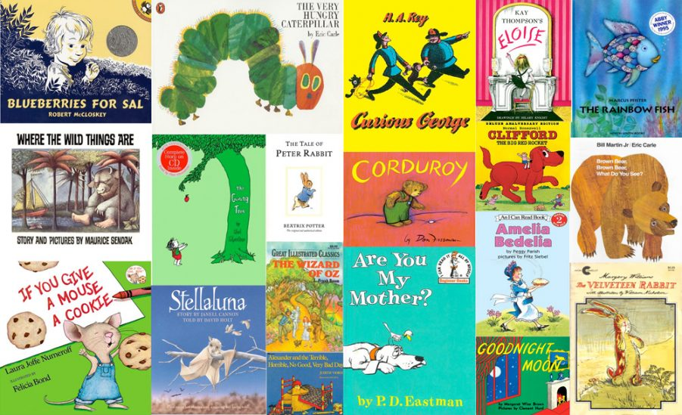

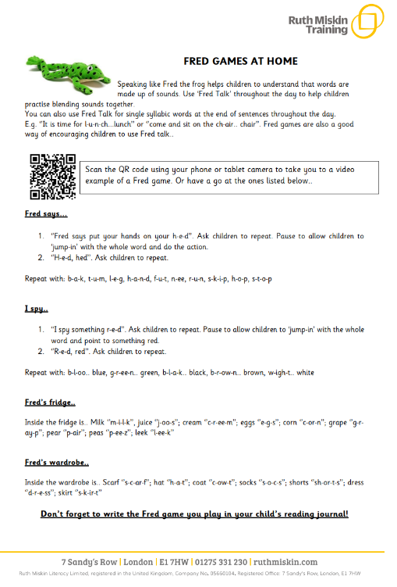
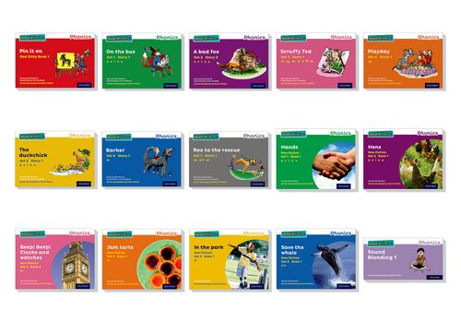

What can you do at home to help?

Slide 13
Thank you for coming!

