Slide 1

Phonics at Whitley Park
Year 1 parents meeting

Slide 2
Welcome!

Slide 3
Why is reading so important?
Reading is the key to unlocking a child's wider learning
Reading helps build children's vocabulary, imagination and understanding of the world around them
At Whitley Park we help children learn to decode words, build fluency and nurture a love for reading and story books.

Slide 4

Read Write Inc.
It is a highly effective phonics-based reading programme that helps children learn with confidence and enjoyment
Through these fun, interactive, fast-paced lessons, children learn to become independent readers
Children make progress at their own level

Slide 5
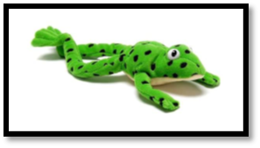
In Reception your child was taught to..
Say the sound that is represented by each letter or groups of letters.
Know how to blend the sounds together in a word to read it, e.g. c-a-t, cat.
In Read Write Inc. We call them 'speed sounds' because we want children to read them effortlessly.
We use pure sounds, rather than letter names, so the children are able to blend the sounds with ease.

Slide 6
Handwriting
Each letter sound has a picture – these are on the sound mats in your home reading packs
Each picture has a rhyme to help the children remember how to write them
It is really important to practice writing in lower case letters

Slide 7


m - Maisy, mountain, mountain
s - slither down the snake

Slide 8
Groupings
Each child is carefully matched to a group through half-termly assessments
Group A
Group B
Group C
Ditty
Red
Green (End of Reception expectation)
Purple
Pink
Orange
Yellow
Blue (end of Year 1 expectation)
Grey
Comprehension (Spring term expectation for Year 2)

Slide 9
Green words
ship | sh | i | p
Once your child can use orally blend, they will learn to blend written words.
The green word cards have a dot or “sound button” under each sound.
Words that contain “special friends” (two letters which together make one sound such as sh, th, ch) have a line under the letters that make up the “special friends”.

Slide 10
Red words
These are words that the children can’t use “Fred Talk” to read.
Children learn these words through regular exposure and explicit teaching.

Slide 11
Now that your child is in Year 1, they will learn..
How to recognise and blend set 2 and 3 sounds
To read with speed and fluency
To decode unfamiliar words (alien words)

Slide 12
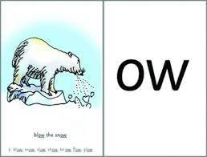
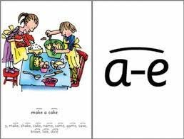
Set 2 and 3 sounds
Once your child is confident in set 1 sounds, they will learn set 2 sounds, then set 3.
These sets introduce new ways of spelling the same sound, as well as more complex sounds
For example, ay in day makes the same sound as ai in rain
As children become more confident in set 2 and 3 sounds their reading becomes smoother, more accurate and more fluent
The sounds, and their rhymes, can be found on the sound mats included in your home reading packs

Slide 13
Reading with speed and fluency
We teach fluency by doing 'speedy reading' sessions in lessons
We teach them to use 'fred in your head' and speed them up with more exposure to words
Reading with fluency and pace plays a huge role in children understanding what they have read – building their comprehension

Slide 14
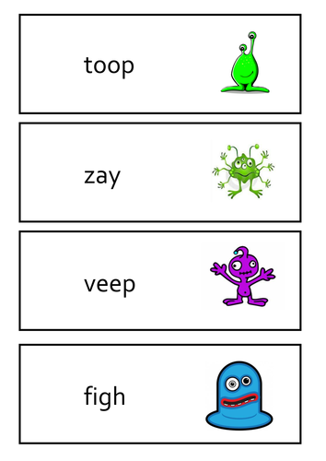
Alien words
It is important that children learn to decode unfamiliar words with confidence
We call these made-up words 'alien words'
They are a jumble of sounds that the child is familiar with
Reading alien words regularly will help children with the Phonics Screening check at the end of the year

Slide 15
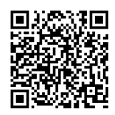


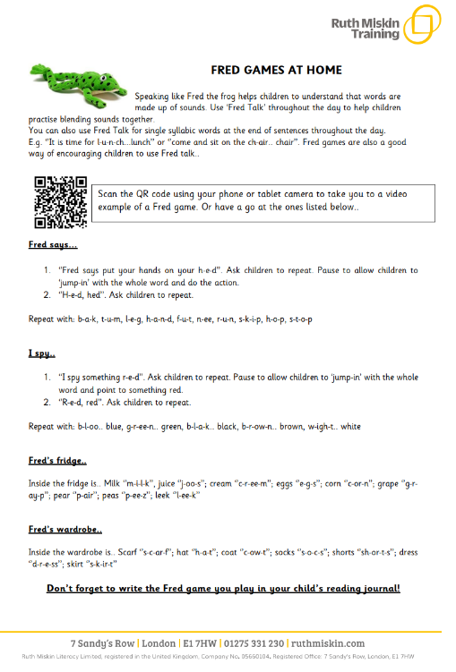
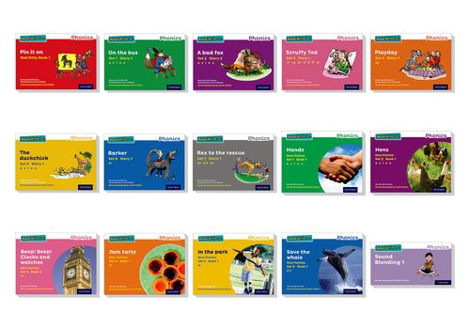

What can you do at home to help?

Slide 16
Thank you for coming!

