Slide 1

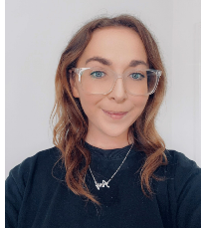
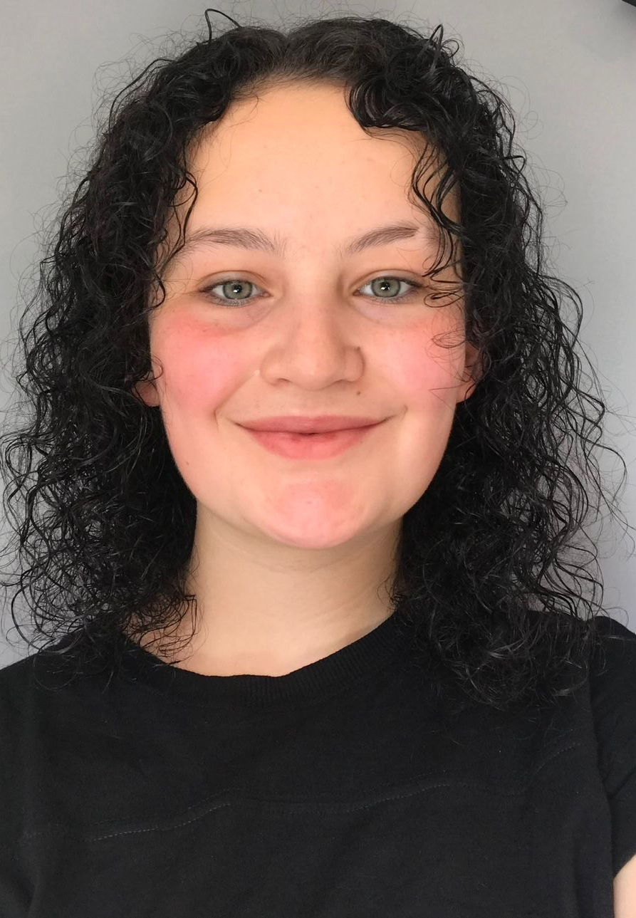
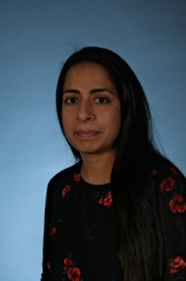
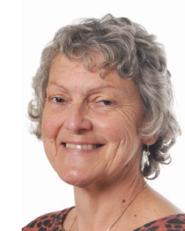
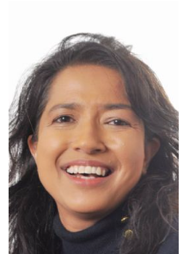
Welcome to Year 3
Miss Corboy
Class Teacher
Team Leader
Miss James
Class Teacher
Mrs Merchant
Mrs Clare
Mrs Sarkar
Notes:
Thank you so much for coming.

Slide 2
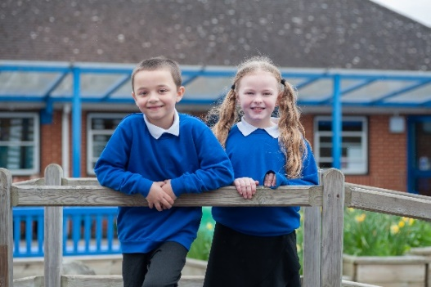

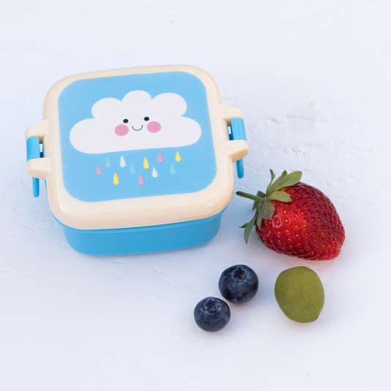


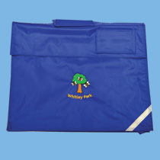


What your child will need
School Uniform
Black or grey trousers or shorts in warmer weather
Or black or grey skirts or pinafore dress. Blue and white school summer dresses can be worn in warmer weather
A royal blue jumper/sweatshirt or cardigan.
Black shoes or trainers
Please name all clothing.
PE day - Wednesday
You will need to order your school meal via Parent Pay or bring a healthy packed lunch which must not include nuts, sweets
or fizzy drinks. Children
can also bring an
additional healthy snack.
Please come dressed in PE Kit on Black joggers or black shorts in warmer weather
White T-Shirt
Dark sweatshirt/hoody
Black or white trainers
X No football shirts or branded
items.
Each day you will need your book bag…
and water bottle.
Please ensure this only contains water; no juice or squash. thank you.
Please do not bring any toys/ fiddle toys to school unless agreed by the class teacher
Notes:
Recent research evidence demonstrates that...
Consistency across home and school promotes achievements for young children
Family involvement in children’s learning has an influence on children’s happiness, achievement and learning
Parent/school partnership can improve children’s motivation, behaviour and self-esteem and language development
We have been to visit all of the children at pre school over the last couple weeks- great to see them in a familiar environment

Slide 3
Typical school day in Year 3
8:45 – School begins and registration
8:45 -9.00 – EMT
9:00-9.40 – Guided Reading/Phonics
9.40-10.40 –English
10.40-11.00 – Break time
11.00-12.00 – Maths
12.00-12.30 – Timetables
12.30-1.30 – Lunch
1.30-2.00 – Mastering Number & Spellings
2.00-3.00 - Topic
3.00-3.10 – Story time
3.15 – Home time

Slide 4
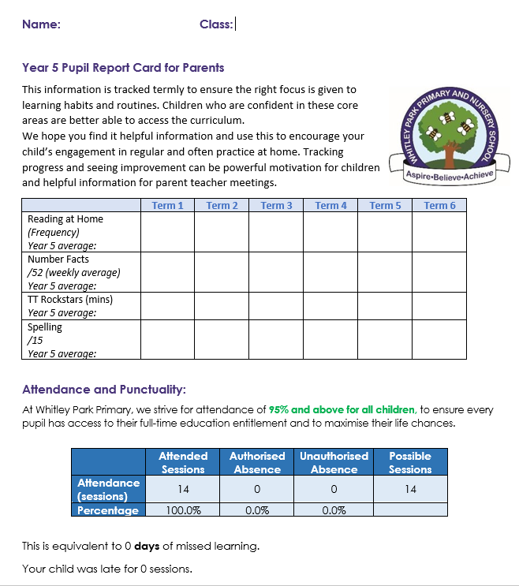
At Whitley Park, we strongly believe that children learn best when there is a strong partnership between school and home. When parents are informed and actively support their child’s learning, progress is strengthened.
Children having fluency in the core skills of reading , spelling and number are essential and the best way to ensure this fluency is through regular practice both in school and at home.
Our recent letter detailed how we will report to you on your child’s progress across the year in these key areas.

Slide 5




Reading
Spelling
Children read at home at least 4 times a week
Please record this in their reading record books
Reading records and reading books need to be in school each day
The number of reads each child has done will be recorded each week
Children will bring home a spellings sheet weekly
Encourage them to practice the spellings at home and find more words with the same rule
Each half term children will be tested on the spelling rules for their year group so you can track their progress across the year
Times Tables
Number Fluency
Children have their login for times table Rockstars in their reading record book
We encourage daily practice of these using the fun and interactive games
The amount of minutes they spend on here will be reported each half term
Children have 4 sessions a week of number fluency, each half term they are tested against their year group objectives and their score will be reported in the half termly report

Slide 6
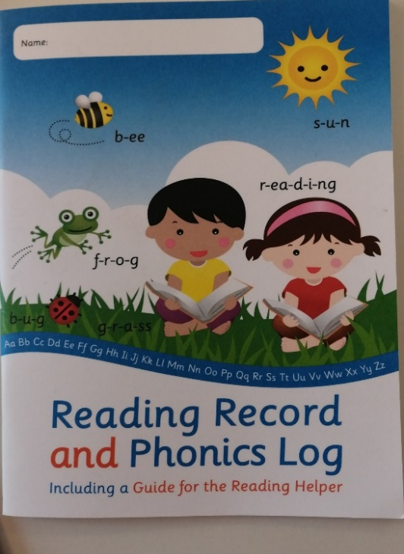
What we will learn about this year
We are looking forward to an exciting year ahead that will build upon your child’s experiences and achievements in Year 2. We aim to offer the children inspiring, topics and enrichment opportunities that engage, motivate and challenge them.
The Curriculum Topics we have chosen to cover this year are:
Autumn Term: ‘Stone Age’
Spring Term: ‘From Farm to Fork’ and ‘Passport to Europe’
Summer Term: Roman Empire and ‘Somewhere to Settle’
Please visit our website to find out more about what your child will be learning in Year 3.
Reading
Reading continues to be of significant importance throughout year three. If your child is still on the Phonics programme, they will continue to have Phonics lessons 4 times a week to focus on sound knowledge, decoding and fluency. Those children no longer on the programme will have Guided Reading sessions focusing on retrieval and inference skills.
Children will be given a new reading book each week, please assist them
by reading with them daily and completing their Reading Record.
Children must bring their reading books and bags to school every day.
Your child will bring home weekly spellings to practise and there will be a half termly spelling test.

Slide 7






Literacy
We recently introduced a new Writing, Reading and Spelling scheme to focus on developing children’s literacy skills. This has already had a positive start and means that children will be exposed to a wide range of high quality texts to support their reading and writing.
We have made a huge investment in books, which means that children have a copy one between two for all writing and reading lessons.
Spelling
The new spelling scheme is linked to our writing text to give the children an opportunity to apply the spelling rule they are learning in their writing. Children will be bringing home a list of spelling words to practice at home.

Slide 8
Trips, visits and enrichment
Upcoming events this Year (to be confirmed):
Autumn Term – Stone Age visitor to school
Spring Term - local supermarket
Summer Term – Ufton Court - Romans
Notes:
Prime areas are a focus during first half of autumn term to enable the children to achieve in the specific areas.
If you can’t talk about it- you cant write about it
If you cant do large movements/ fine movements you cant hold a pencil
If you are worried/ anxious/ falling out with friends- not happy and secure to learn other things

Slide 9
Attendance
With your continued support we have increased our attendance to 92.9% ( 2% increase). Although this is a step in the right direction we are still not at the government target of 95%.
We know that there is a direct link between attendance and progress and ask for your continued support in ensuring your child is in school each day .
There have been updates to the government policy in August 2024 for consecutive absences of 10 or more sessions ( generally 5 days) where the fine has now increased to £80 per parent , per child.
Please do come and talk to us if we can support in with any issues related to your child’s attendance.

Slide 10

Attendance and medical matters
It is important that your child attends school every day
Any sickness and/or diarrhoea, must be followed by 48 hours absence.
Any absence requires an email to the office or telephone call explaining why.
Head lice are common! Please check regularly and treat as recommended.
Any medicines can only be administered by prior arrangement. Forms are available from the school office
If your child receives first aid from school, you will receive a note explaining how this occurred and what treatment was administered. You may receive a call or text depending on the severity of the accident or injury. All year groups in school have a number of named first aiders who will deal with injuries in the first instance.
Children must not have any medication in their personal belongings. School must be made aware of any medication a child needs
TELEPHONE0118 937 5566
EMAILoffice@whitleypark.reading.sch.uk

Slide 11

Talk to Us
We look forward to working in partnership with you in Year 3
We welcome open, honest communication with you and our door is always open. Please be mindful that we generally have
more time at the end of the school day as we are very busy in the
mornings making sure that your children are transitioning happily into school
If you have any concerns, queries or anything you would like us to be aware of then please email the office or speak to teaching staff at the end of the school day.
Notes:
Focused on how children learn. Do they come up with their own ideas/ make links in their learning/ challenge themselves/ persevere/ make predictions and test them out etc.

